Slide 1
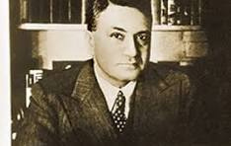
J.C Mahindra (Jagdish Chandra Mahindra)
co-founders of Mahindra & Mahindra
Nitesh Singh Rajput
BCA 4M

Slide 2
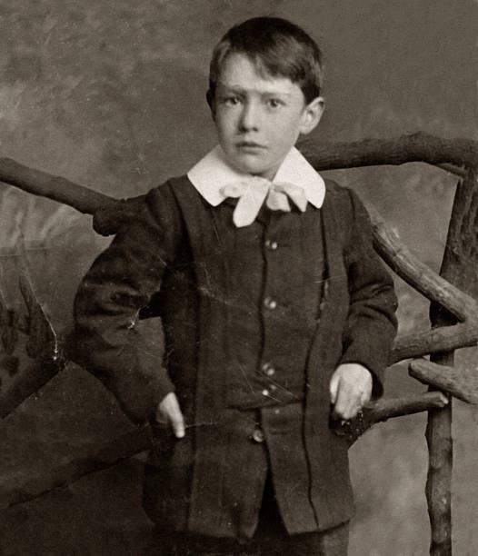
About
01
Born in 1892 in Ludhiana
02
Lost Father in his childhood
03
Engineering degree from VJTI

Slide 3
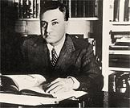
Career
Work in Tata Steel as a Senior Sales Manager
During WW2,became first Steel Controller of India
offer from different different agencies

Slide 4
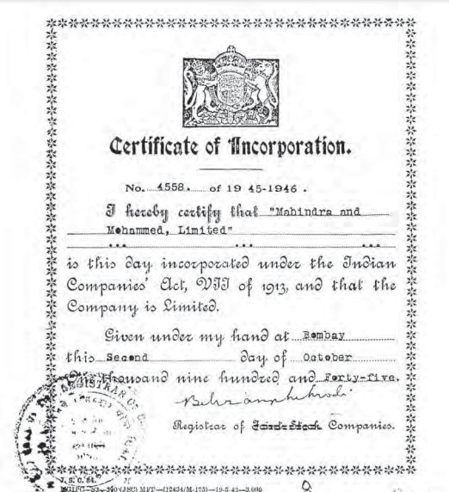
Mahindra & Mohammed
He sell his house
Start a Steel company
With his brother K.C Mahindra and partner Malik Ghulam
Mohammed
Company name was “Mahindra and Mohammad”

Slide 5
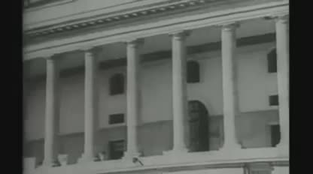
India got independence

Slide 6
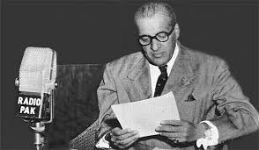
Malik gulam , moved to Pakistan

Slide 7

Impact on the firm by malik mohammad left
Leave India and become finace minister of pakistan
Huge impact on comany because he
had huge stake in the company
Its Hard Time for M&M
Everyone thinks its end of M&M
But JC Mahindra did’t lose hope
and prove them all wrong by bring
company back in well condition

Slide 8
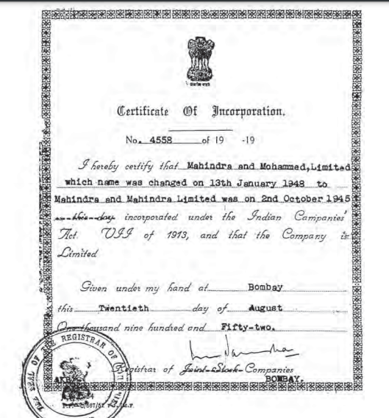

Company Name Change
The company needed a new name
after malik
But Budget problem
officially renamed Mahindra & Mahindra
Save Money of reprint Logo and stationery

Slide 9
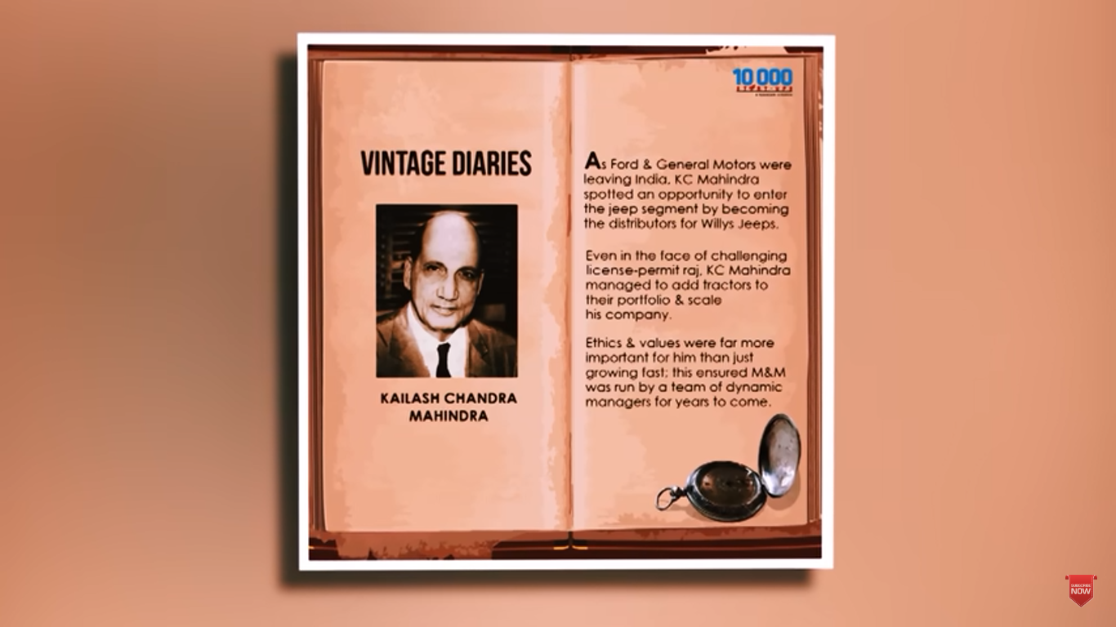
Willys Jeep in India
Mahindra brothers find out
opportunity
Jeep Segment was empty in
India
got the license to assemble and sell Willys Jeeps
become India’s leading automobile company

Slide 10
Sir J.C. Mahindra passed away in 1951

Slide 11
What We Learned from J.C. Mahindra :
Vision & Pursuing Opportunities
Hard Work & Determination
Problem-Solving Skills
Never-give-up attitude

Slide 12
Thank you.......

